Slide 1

Strategy for community engagement in open science
26th November 2025 | 10.5281/zenodo.17725982 | CC-BY-4.0

Slide 2
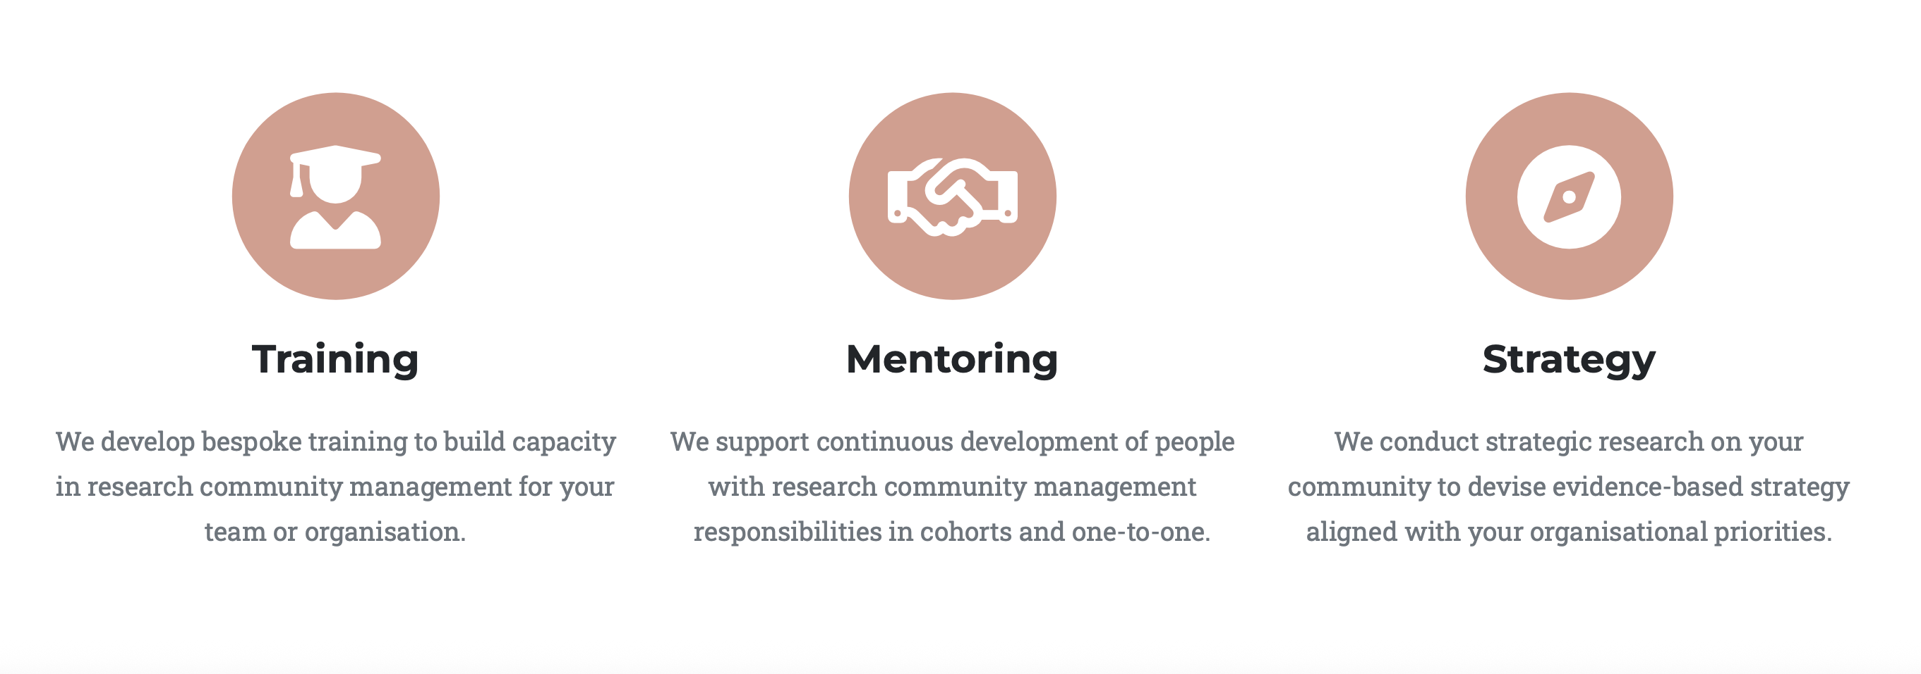
About RCM Cooperative

Slide 3
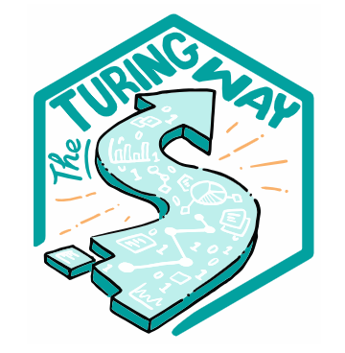



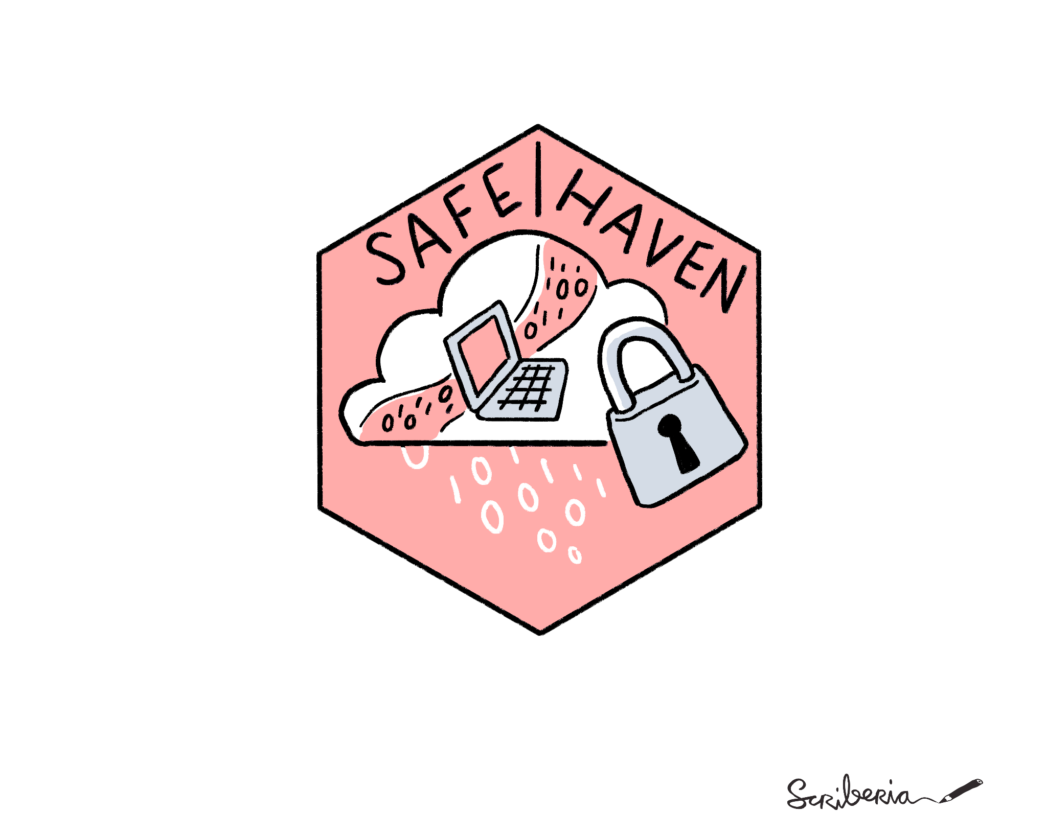

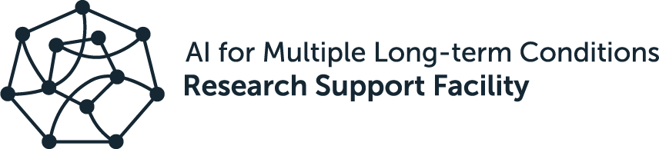







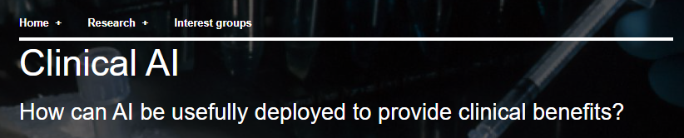



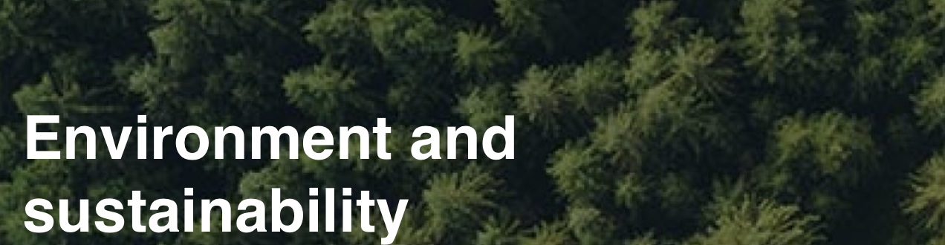



Communities we have managed and supported
Modelling and high-precision forecasting of complex environmental systems to make leaps in weather prediction and sustainable energy

Slide 4
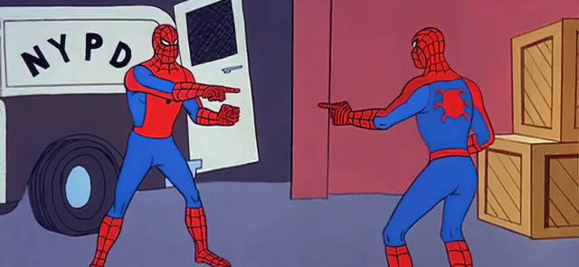
Open Science
Research Community Management
transparent, reproducible, ethical, collaborative
Define objectives for the community
Baseline success against objectives
Strategy for development
Implementation tactics
“concrete recommendations for improving TOSIs programs, creating new ones or eliminating them, if necessary.”

Slide 5
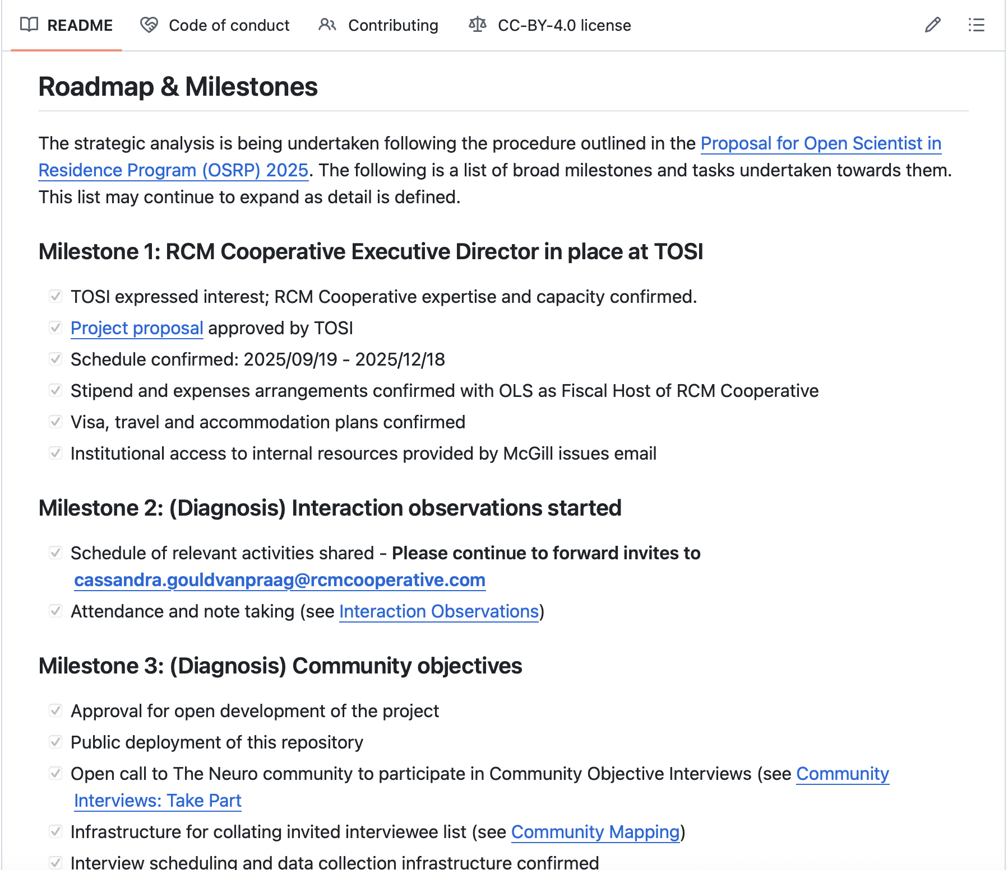
https://github.com/rcmcooperative/partner-TOSI
Open Scientist in Residence
Define objectives for the community
Baseline success against objectives
Strategy for development
Implementation tactics
“concrete recommendations for improving TOSIs programs, creating new ones or eliminating them, if necessary.”

Slide 6
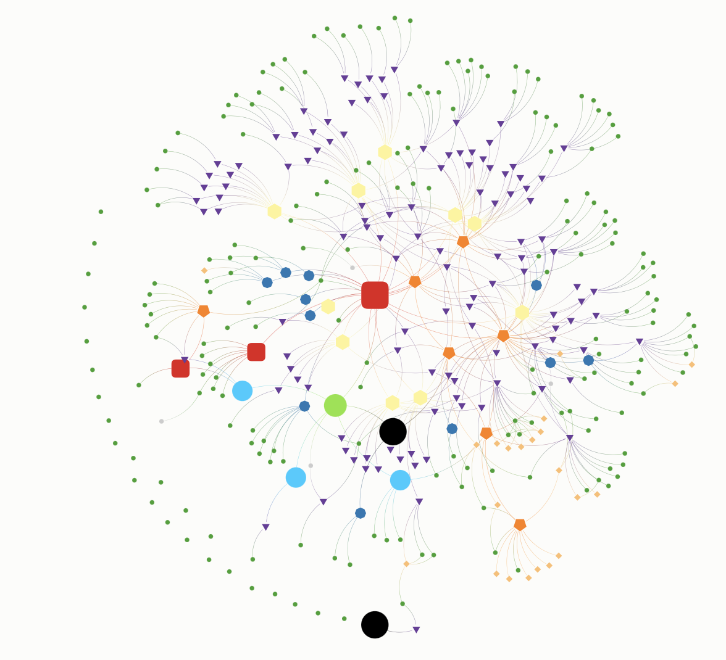

Engagement mapping (baseline)
People
Affiliations
Initiatives
Interactions
Tools

Slide 7
Defining objectives
15h observations of community activity
10h meetings with TOSI
12h 1-2-1- interviews:
PIs: 5
Staff/Researchers: 5
Trainees: 7

Slide 8
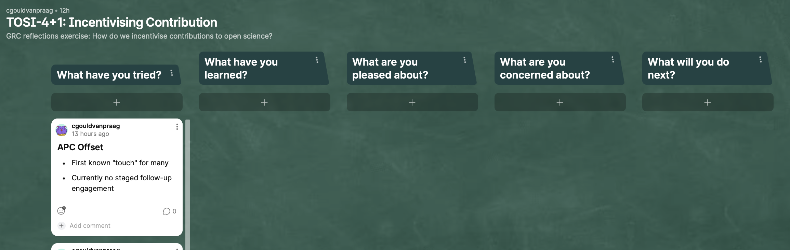
https://tinyurl.com/TOSI-GRC-2025-11
GRC reflections

